Slide 1
Team name:Spark
N.NIVEDHA-727821TUEC129
S.M.KARTHIKEYAN-727821TUEC105
R.PRIYADHARSHINI-727821TUEC138
G.SENTHAMILSELVAN-22LEC006
N.POOJA-727821TUEC131
M.RAASIKA-727821TUEC141

Slide 2
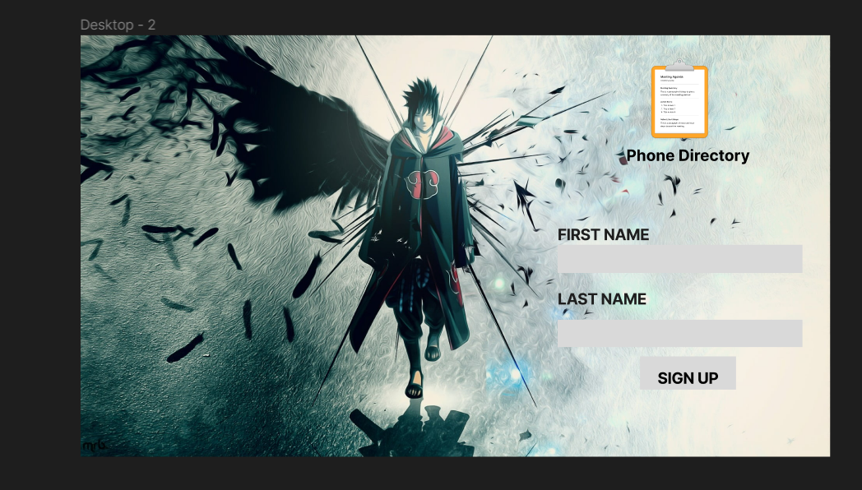

Slide 3
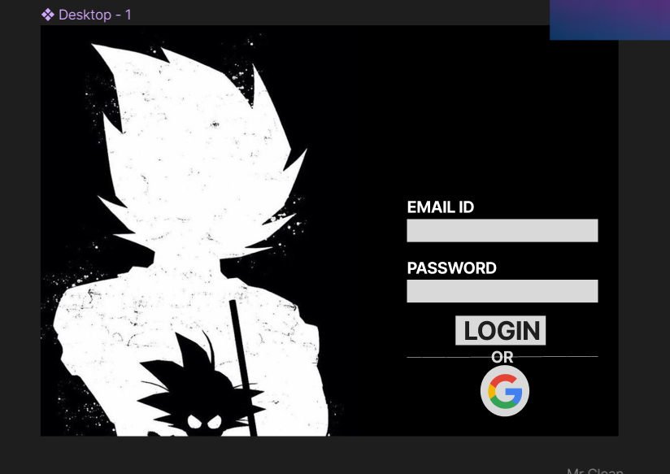

Slide 4
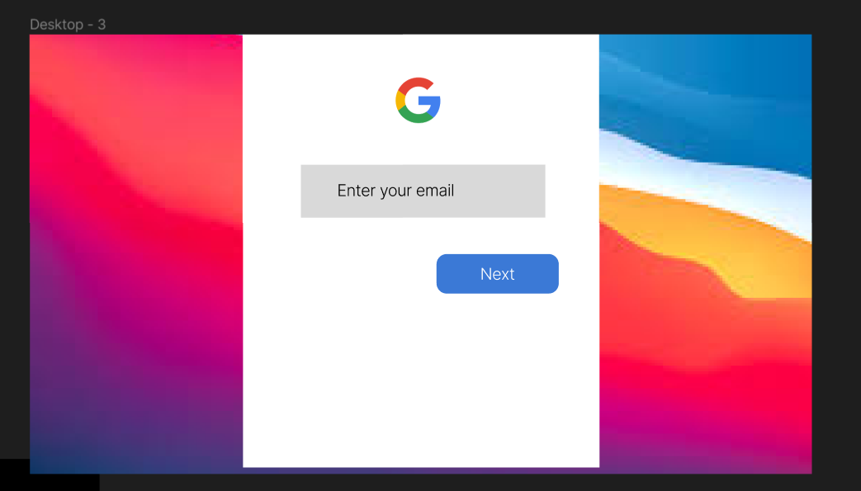

Slide 5
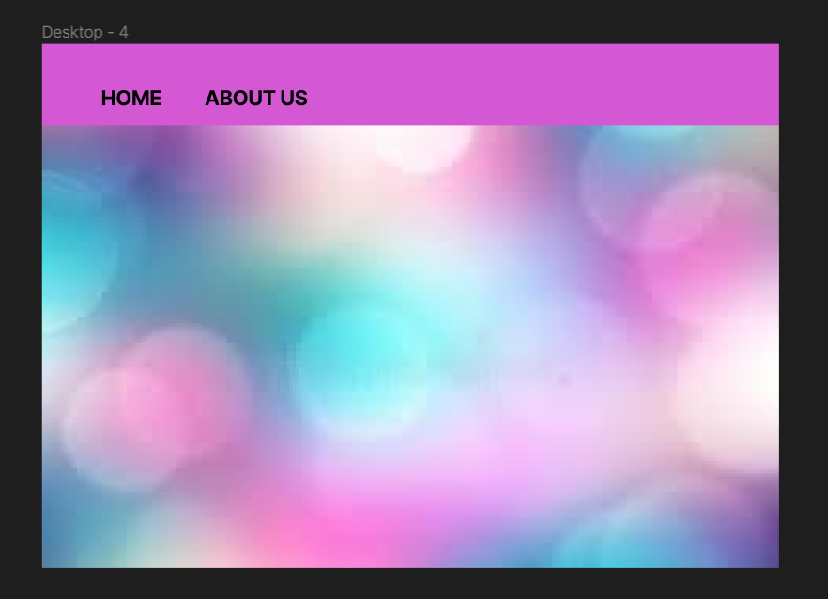

Slide 6
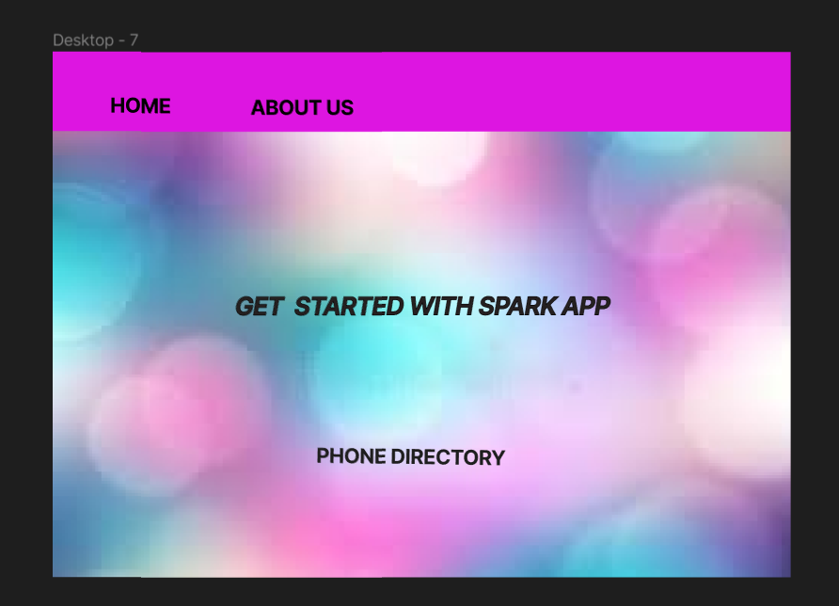

Slide 7
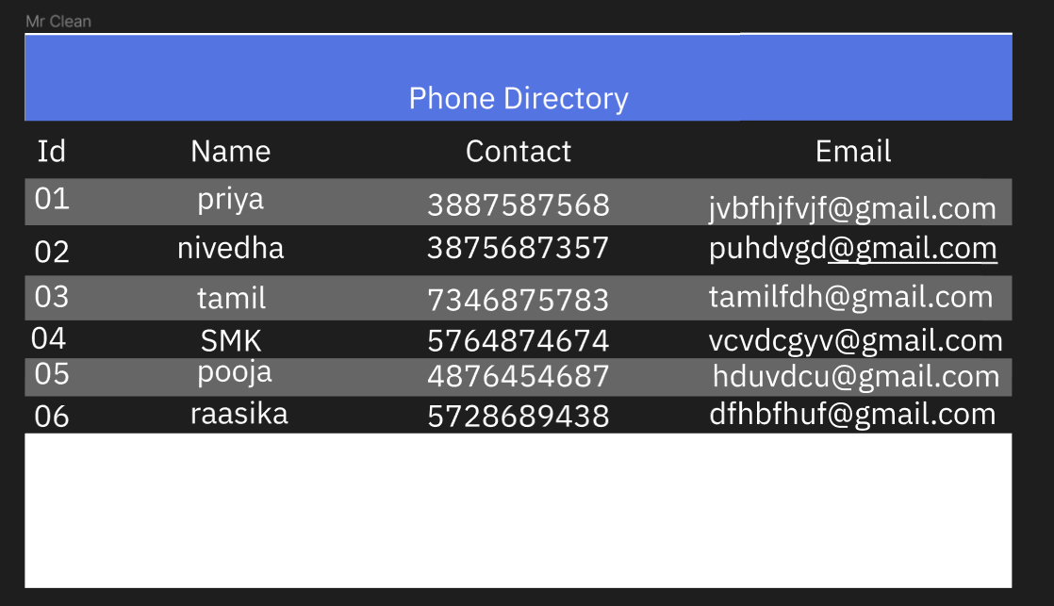

Slide 8
SOURCE:FIGMA URL: https://www.figma.com/file/wUOAqCZjDOKVJ5C6OaEci8/Untitled?node-id=0%3A1

Slide 9
THANK YOU

